Slide 1

Data Structure
Your success is our success
Funny Gorilla 诙猩猩
Notes:
Notes for title slide

Slide 2
Data Structure
List interface allows null and duplicate values and retains the order of insertion of objects.
Set doesn’t allow addition of duplicate objects.
Queue is a linear collection that supports FIFO.
Deque is a linear collection that supports the insertion and removal of elements at both its ends.
Map interface allows to store key/value paires

Slide 3
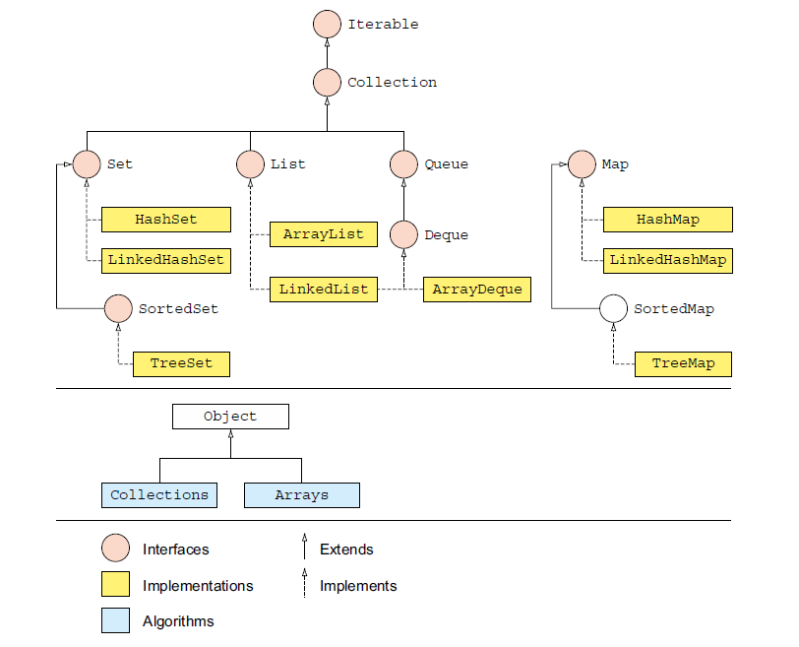

Slide 4
List
an ordered collection that allows us to add and remove elements like an array.

Slide 5
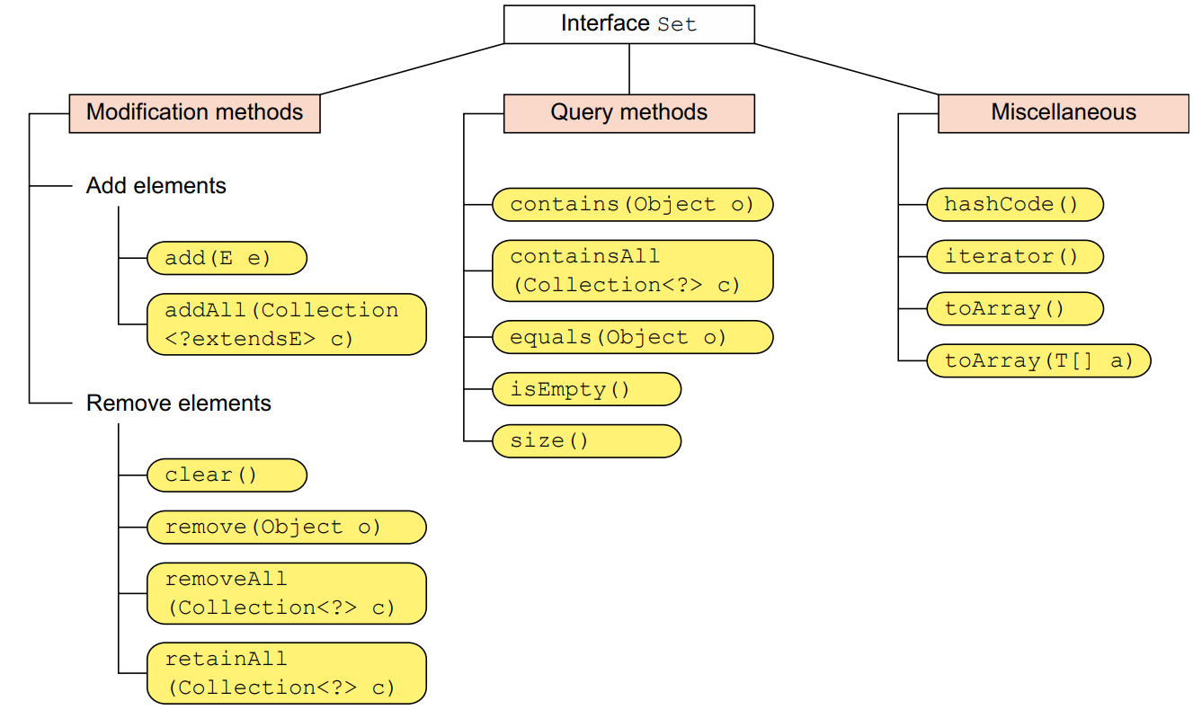
List
an ordered collection that
allows us to add and remove elements like an array.

Slide 6
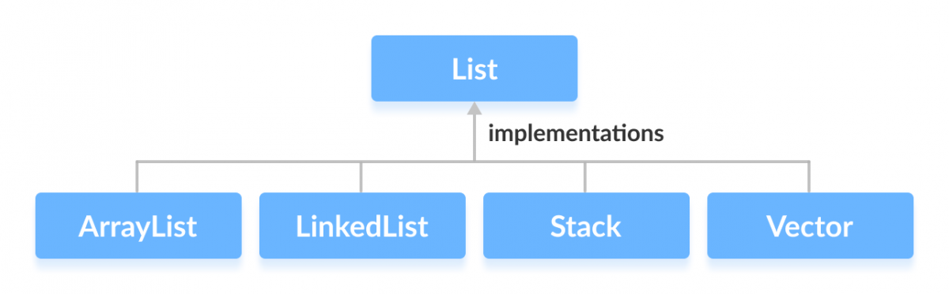
List
an ordered collection that
allows us to add and remove elements like an array.

Slide 7
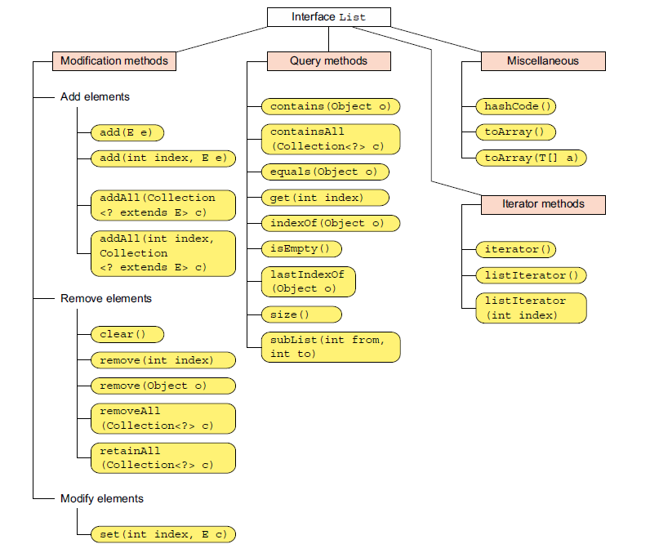

Slide 8
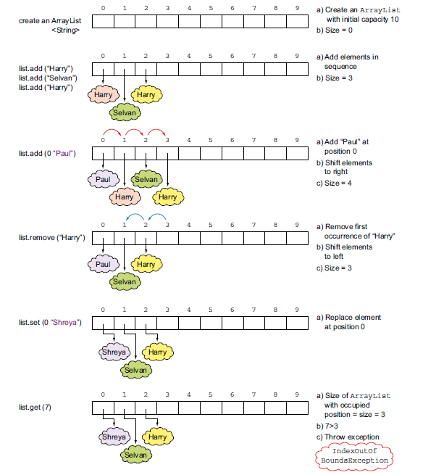
ArrayList
List<String> list = new ArrayList<>();

Slide 9
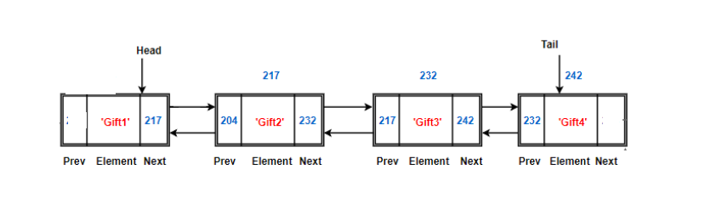
LinkedList

Slide 10
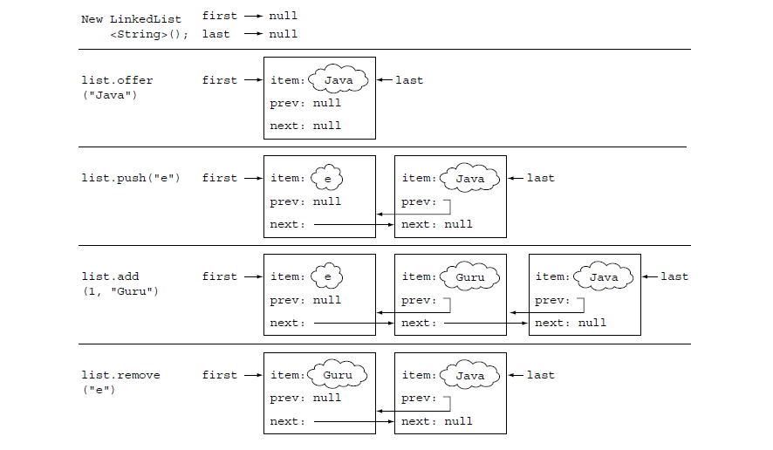

Slide 11
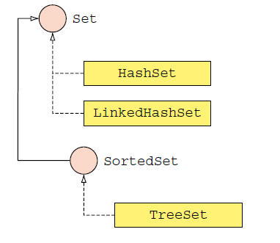
Set
allows us to store elements in different sets similar to the set in mathematics. It cannot have duplicate elements.
each key has a single value associated with it.

Slide 12
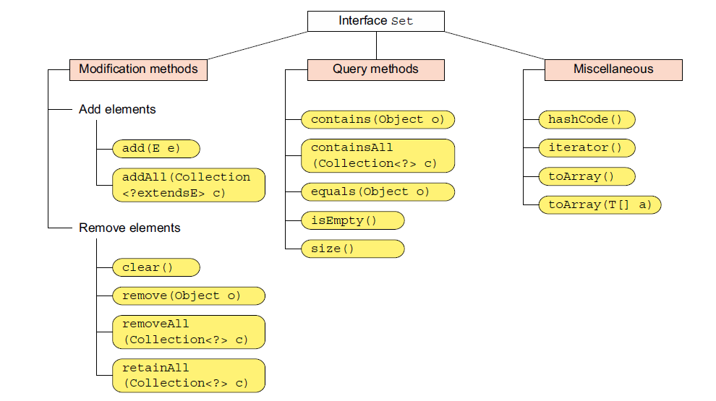

Slide 13
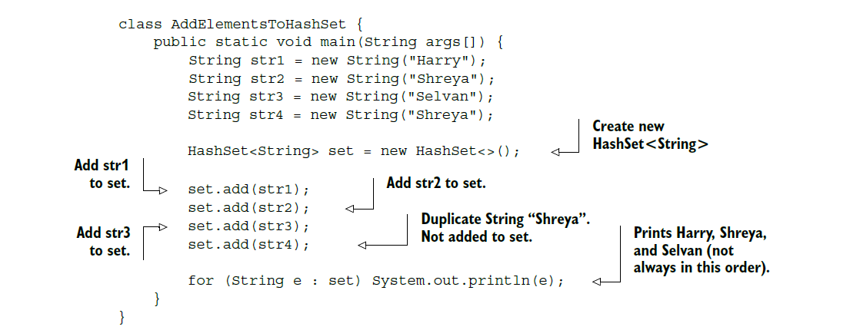
HashSet

Slide 14
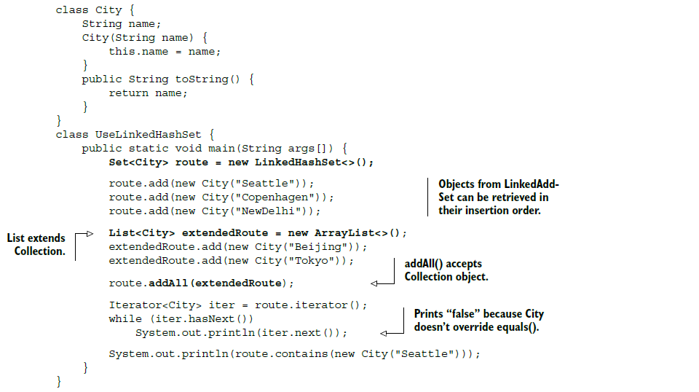
LinkedHashSet

Slide 15
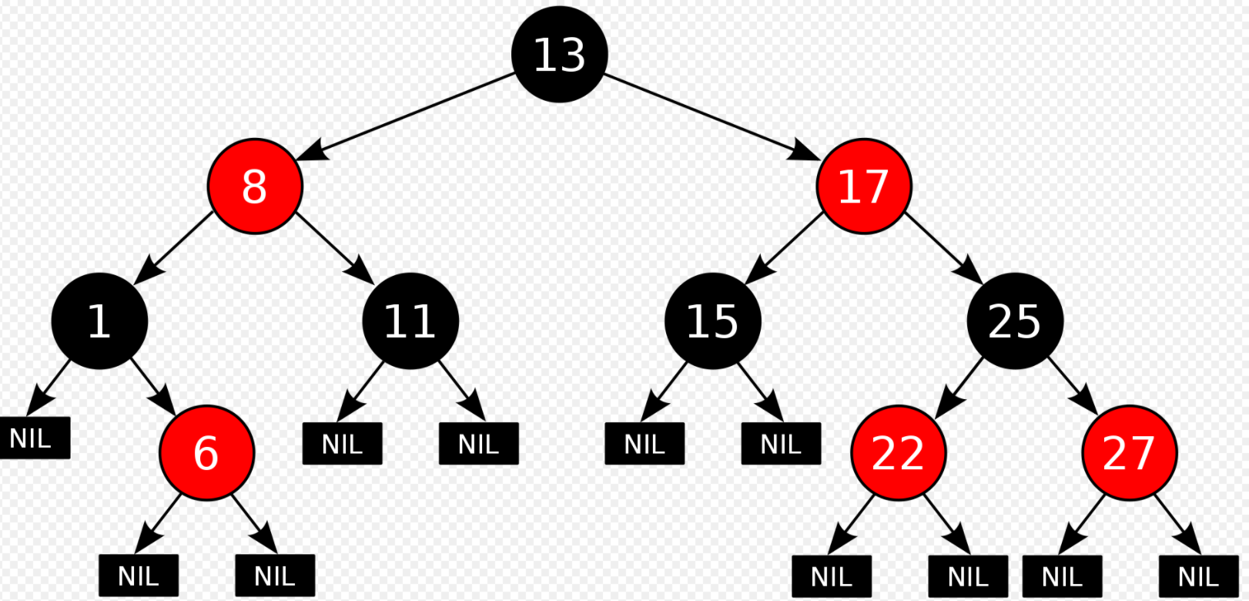
TreeSet

Slide 16
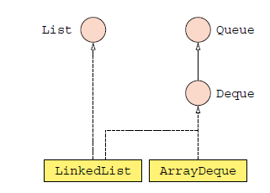
Queue
used when we want to store and access elements in First In, First Out manner.

Slide 17
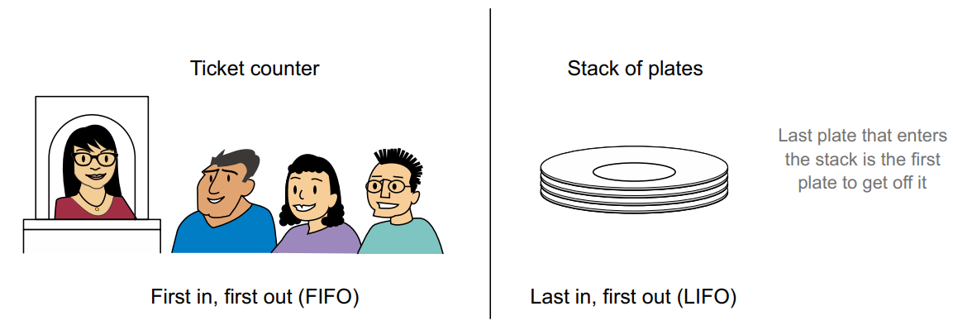
Real life examples

Slide 18
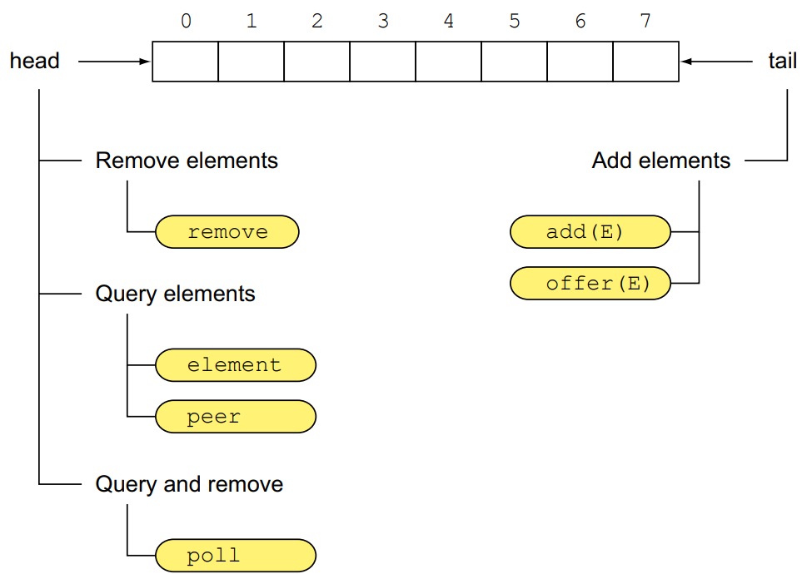
Queue Methods
Queue methods used to work with Deque as a FIFO data structure

Slide 19
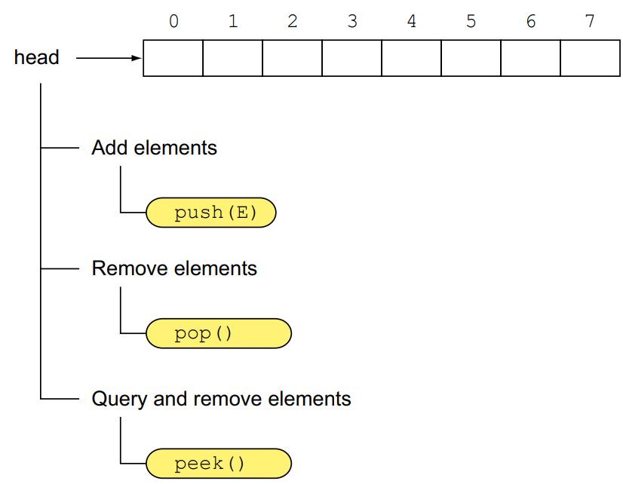
Stack Methods
The stack methods used to work with Deque as a LIFO data structure

Slide 20
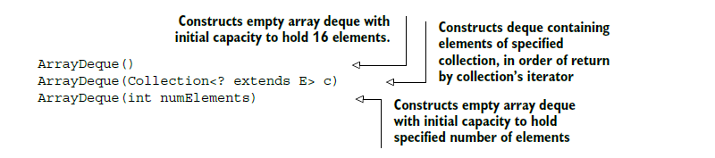
ArrayDeque

Slide 21
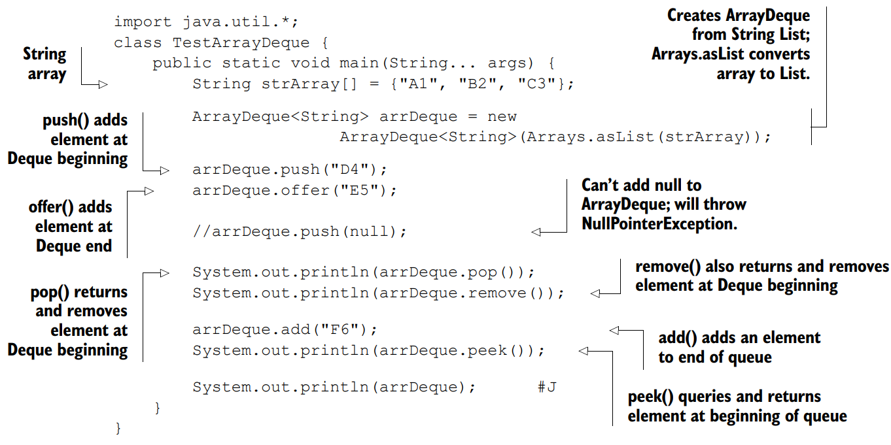
ArrayDeque

Slide 22
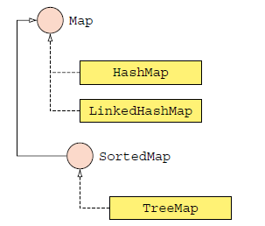
Map
each key has a single value associated with it.
allows elements to be stored in key/value pairs. Keys are unique names that can be used to access a particular element in a map. And, each key has a single value associated with it.

Slide 23
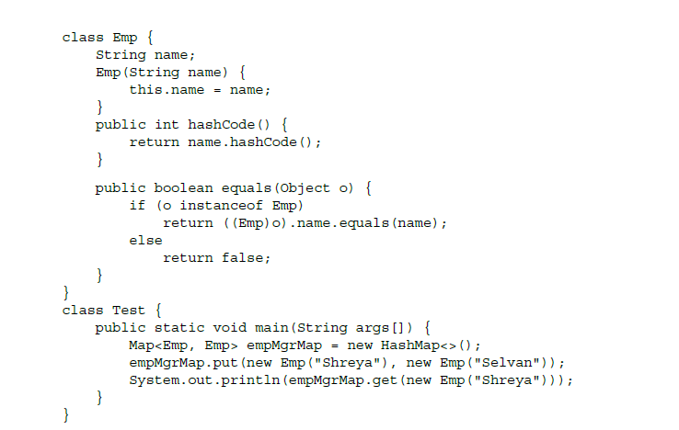
HashMap
a hash-based Map that uses the hash value of its key (returned by hashCode()) to store and retrieve keys and their corresponding valu.
The keys of a HashMap aren’t ordered.

Slide 24
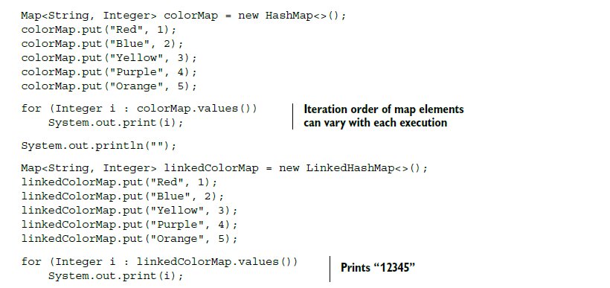
LinkedHashMap
maintains a double-linked list that runs through all its entries.
This linked list is used to retrieve the elements in the order they were inserted.

Slide 25
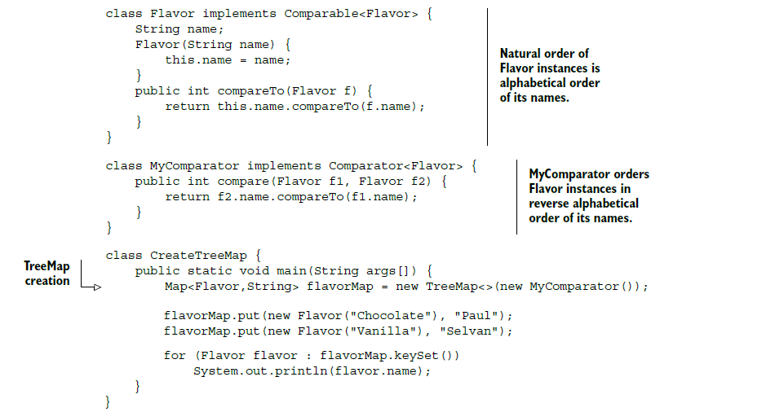
TreeMap
sorted according to the natural ordering of its keys or as defined by a Comparator passed to its constructor. I

Slide 26
Hands-on Coding
Missing Element
Write a function:
Class Solution { public int solution (int[] A) }
That , given an Array A, returns the value of the missing element.
For example,
Input: arr[] = {1, 2, 4, 6, 3, 7, 8}
Output: 5
Input: arr[] = {1, 2, 3, 5}
Output: 4

Slide 27
Reference
https://www.callicoder.com/java-arraylist/
https://www.programiz.com/java-programming/collections

Slide 28
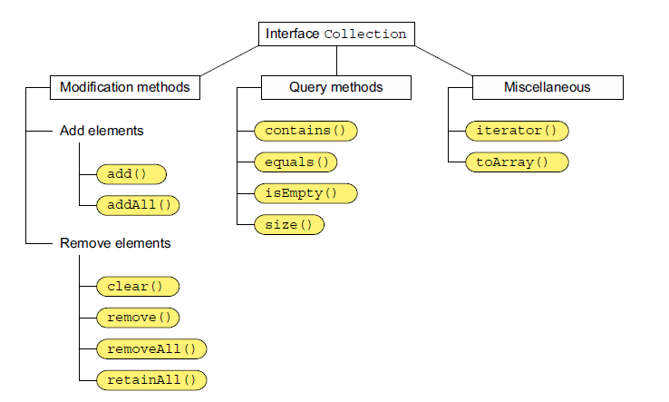
Reference

Slide 29
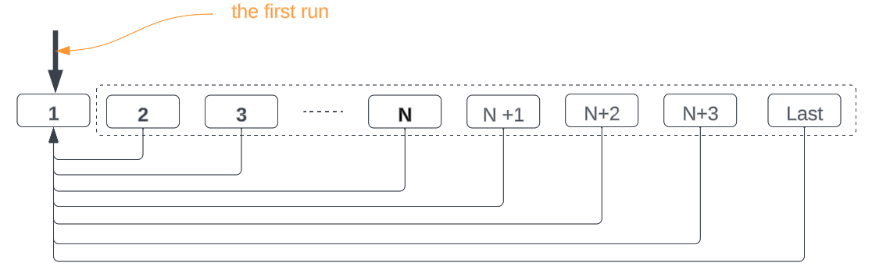
LeetCode

Slide 30
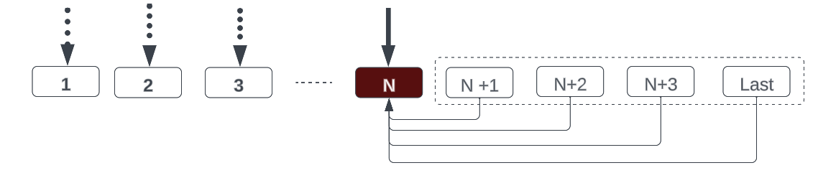
LeetCode

Slide 31
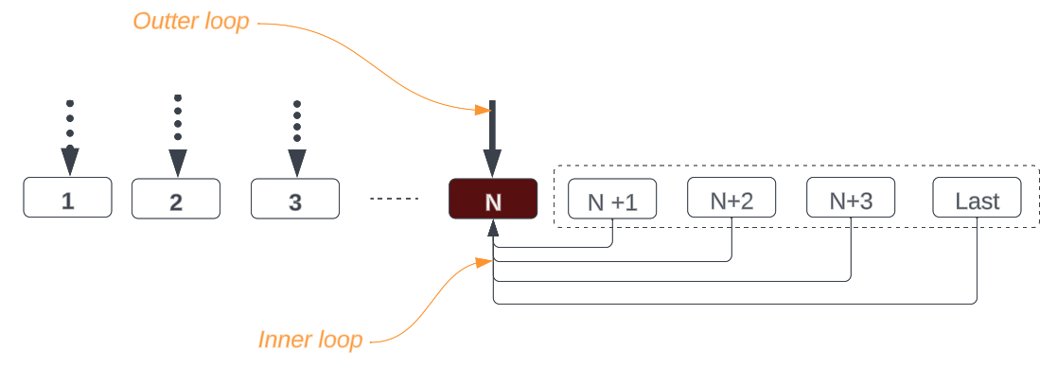
LeetCode

Slide 32

Your success is our success
Contact
Mail: info@funnygorilla.com.au
Linkedin: https://mt.linkedin.com/in/songqing-gu-2ba9034b/de
Web Chat: FunnyGorilla
Phone: 0420891343

